Slide 1
Missing Heritability
Lipika Ray
4th June 2010

Slide 2
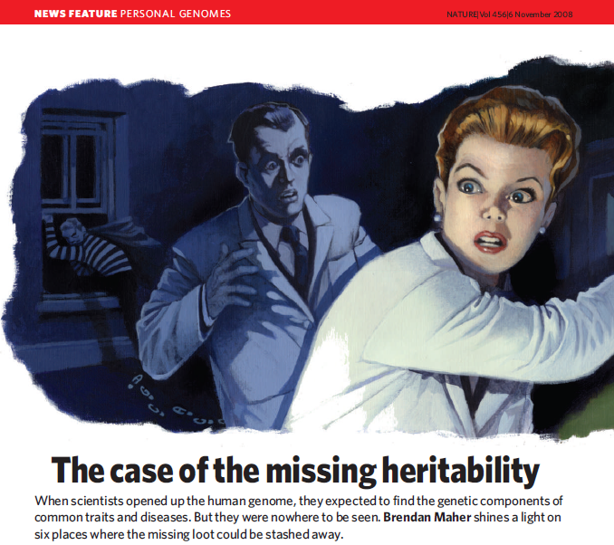
Notes:
Heritability: General meaning → passing from one generation to another; taking by inheritance.
Popular example is height – childrens average height can be estimated by looking at their parents height – that way height is ~ 80% - 90% heritable.
But from gwas data on more than 30,000 people, several genetic variants turned up with tiny effects, accounting for only 5% of height’s heritability.
We need to know how this heritability is defined?

Slide 3
Heritability:
Phenotype (P) = genotype (G) + environmental factors (E)
(observed) (unobserved) (unobserved)
Variances:
Heritability is defined as ratio of variances, by expressing the proportion of the phenotypic variance that can be attributed to variance of genotypic values:
Heritability (broad sense) :
Heritability (narrow sense) :
= additive genetic effects
= dominance genetic effects
(interaction of alleles in same locus)
= epistatic genetic effects
(interaction of alleles in different loci)

Slide 4
Six places where missing loots can be stashed away:
(Maher, 2008)
Right under everyone’s noses:
Limitation of GWAS – inability to get statistical significance of some genes with high penetrant rare variants.
Rare mutations in some gene might have huge effect, but in gwas, averaging across hundreds of people could dilute its effect.
Solution: Need to sequence candidate genes and their surrounding regions in thousands of people – costly.
Ex.: Sequencing of gene ANGPTL4, related to cholesterol and triglyceride conc., in 3500 individuals revealed some previously unknown variants which have dramatic effect on the conc. of these lipids in the blood.

Slide 5
Out of sight:
Middle order variants, moderately penetrant but rare enough to get hooked up by gwas net.
Rare high penetrant mutations in monogenic diseases are under purifying selection, whereas very high penetrant mutations are unlikely playing role in common diseases.
Another possibility: there are many more-frequent variants that have low penetrance that gwas can’t statistically link them to a disease – common disease common variant theory.
Hoping to get some direction from 1000 genome projects.

Slide 6
3. In the architecture:
Copy number variations (CNVs), stretches of DNA tens or hundreds of base pairs long that are deleted or duplicated between individuals.
Wellcome trust common CNV project (April 2010) identified absolutely no novel CNVs associated with complex disease.
4. In underground networks:
Epistasis – one gene masks the effect of another, or where several genes work together – not in the range of gwas – so far no good model of epistasis.
To fill in all the heritability blank, researchers may need better and more varied models of the entire network of genes and regulatory sequences, and of how they act together to produce a phenotype – Leonid Kruglyak, Princeton.

Slide 7
5. The great beyond:
Epigenetics – changes in gene expression that are inherited but not caused by changes in genetic sequence – it’s not clear how methylation pattern is ‘remembered’ by next generation.
One possible explanation: RNA is being inherited alongside DNA through sperm or eggs.
6. Lost in diagnosis:
The common diseases might not, in fact, be common.
If thousands of rare genetic variants contribute to a single disease, and the genetic underpinnings can vary radically for different people, how common is it? Are these, in fact, different diseases?

Slide 8
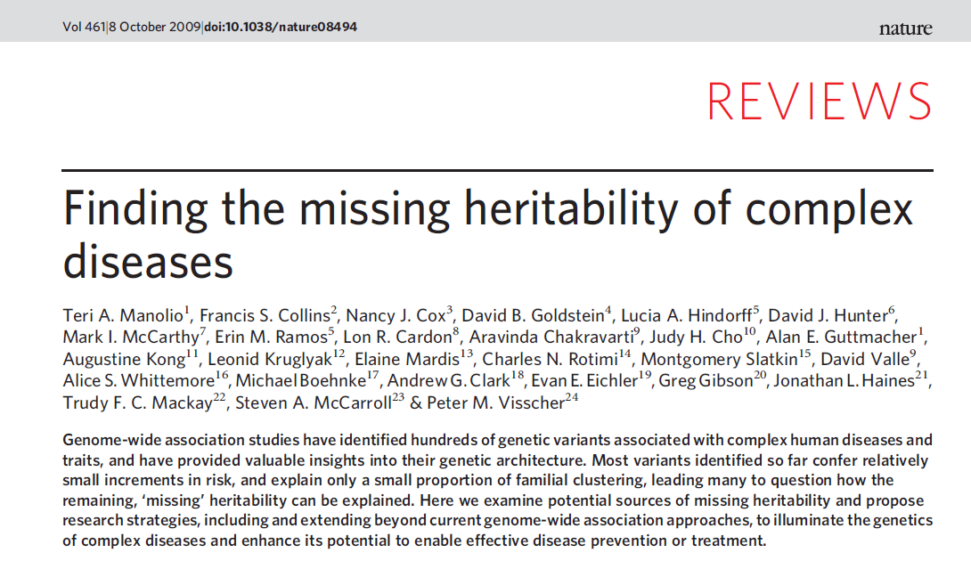

Slide 9
Heritability and allelic architecture of complex traits
Allelic architecture (number, type, effect size and frequency of susceptibility variants) may differ across traits and missing heritability may take a different form for different diseases.
Heritability estimates

Slide 10
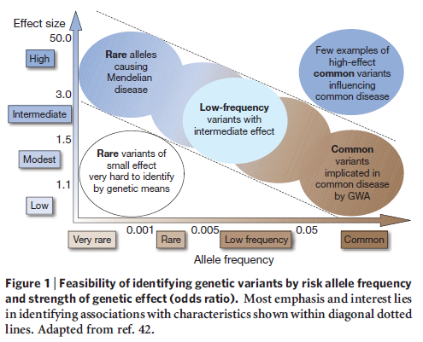
Rare variants and unexplained heritability
Possible contribution of variants of low minor allele frequency,
0.5% < MAF < 5%, or of rare variants (MAF < 0.5%).
To detect association, sample size increases linearly with 1/MAF given a fixed odds ratio and fixed degree of LD with markers and also scales quadratically with 1/|(OR-1)|, thus increases sharply as OR declines.
Low frequency and rare variants will need to have higher odds ratios to be determined.

Slide 11
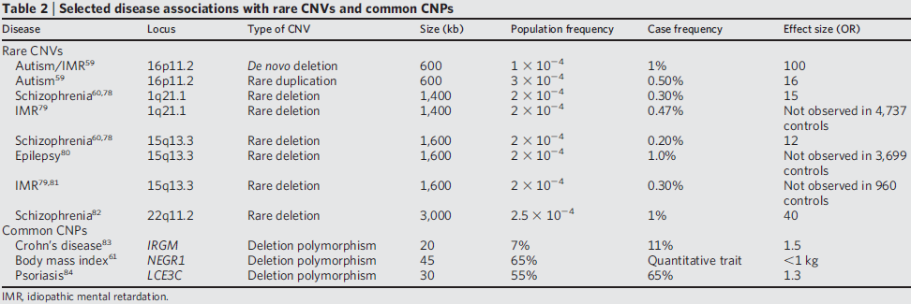
Structural variation and unexplained heritability
Variation due to CNVs arises from a combination of rare and common alleles; as with SNPs most variants are rare but most of the differences between any two individuals arise from a limited set of common (MAF >= 5%) copy number polymorphisms (CNPs).

Slide 12
Harnessing family studies
May facilitate the detection of rare and low frequency variants, and the identification of their associations with common diseases, because predisposing variants will be present at much higher frequency in affected relatives of an index case.
Parent-of-origin specific effects: Augustine Kong et al.
Strategies for existing and future GWAS
GWAS have shown that complex diseases cannot be explained by a limited number of common variants of moderate effect.
Low frequency variants of intermediate effect might also contribute to explaining missing heritability that should be tractable through large meta-analyses and/or imputation of gwas data.
The value of future studies can be enhanced by expansion to non-european samples, less common diseases, including more precise phenotypes and measures of environmental exposures.
1000 genome project for lower frequency spectrum.

Slide 13
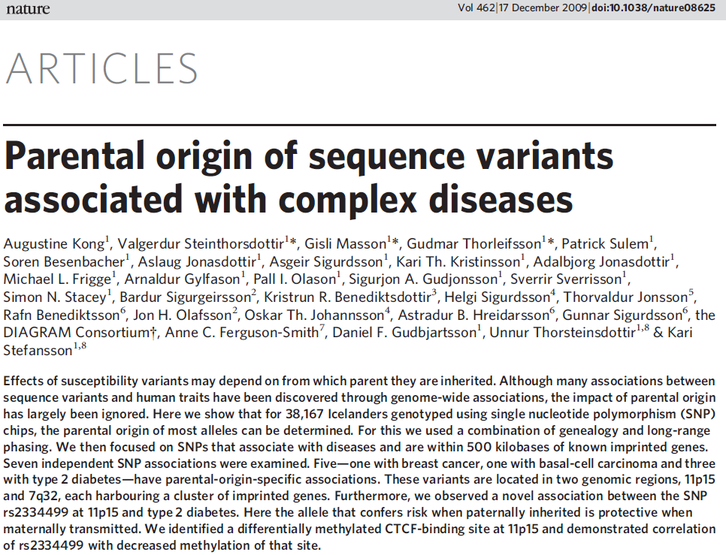

Slide 14
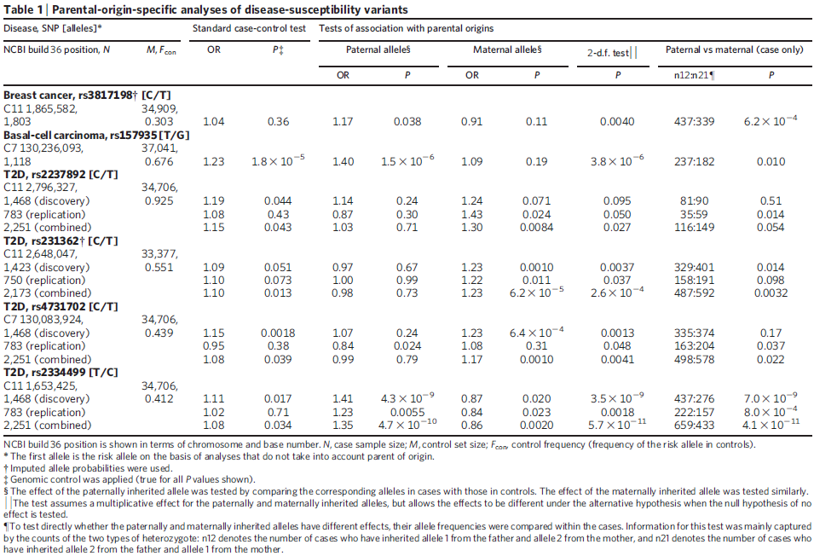

Slide 15
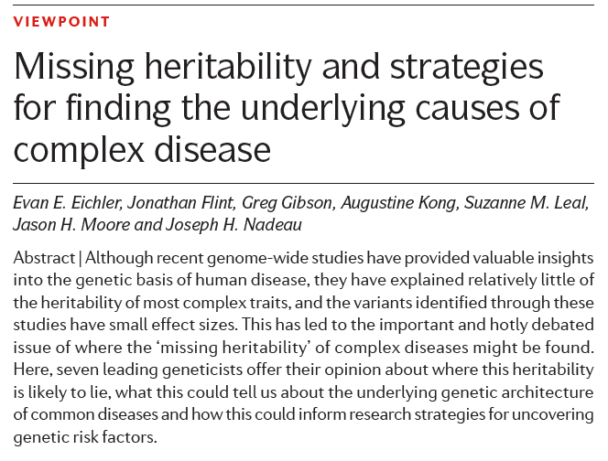

Slide 16
Evan E. Eichler, (Washington School of Medicine, Seattle)
Specific comments:
CNVs: Impact of large variants (deletions, duplications and inversions) that are individually rare but collectively common
CNPs: Several hundred genes that map to regions of CNP duplications. These genes are highly variable among individuals, enriched in genes associated with drug detoxification, immunity and environmental interaction.
Jonathan Flint, (Wellcome Trust centre for Human Genetics, Oxford)
Broad comments:
Genetic architecture, epistasis
Understanding why genetic architecture differs for different traits could help when choosing the correct tools to find the underlying genes and deciding whether to look for common or rare variants, and studying the genetic architecture might even tell us what type of variant to expect.

Slide 17
Greg Gibson, (Georgia Inst. of Technology, Atlanta, Georgia)
Strong comments:
Missing heritability problem is overblown!
Limited GWAS capability – heritability definition – hidden environmental structure.
Missing genetic variance – high false negative rate as true associations are hidden in the fog of random associations.
Difference in the architecture of the disease – Gene-environment interactions – population stratification.
Augustine Kong, (deCODE genetics, Iceland)
Good comments:
Parent-of-origin effects
Epigenetic effects beyond imprinting that are sequence-independent and that might be environmentally induced but can be transmitted from one or more generations could contribute to missing heritability.

Slide 18
Suzanne M. Leal, (Baylor college of Medicine, Houston)
Rare variants – individually rare and collectively frequent.
Analysis of exome and whole-genome sequence data.
Because sequencing uncovers both causal and non-functional variants, methods for analysing rare variants must be robust to misclassification.
Jason H. Moore, (Dartmouth medical school, New Hampshire)
Not a mystery!
Genetic variation influencing the expression of non-coding RNAs
Epistasis
Joseph H. Nadeau, (Case Western Reserve Univ., Cleveland)
Transgenerational genetic effects – epigenetics.

