Slide 1
Chromatin organization marks exon-intron structure
[Schwartz S, Meshorer E, Ast G
Nat Struct Mol Biol, 2009 Sep;16(9):990-6]
Lipika Ray
October 7th, 2009

Slide 2
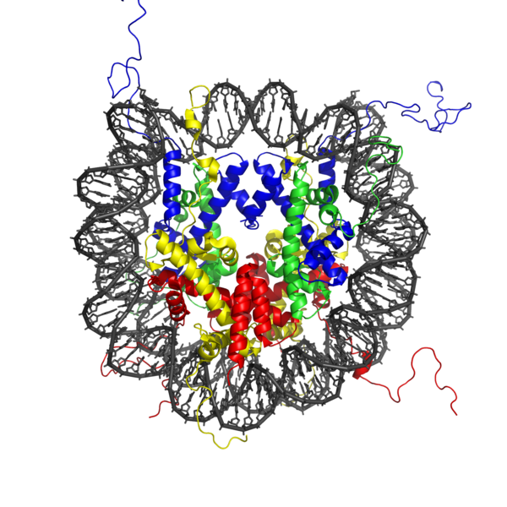
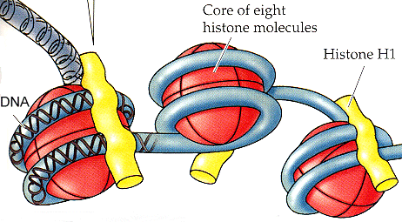
Preface:
Cartoon diagram of how DNA is wrapped around core of histones
Crystal structure of nucleosome core particle
[Ref: Scienceblog.com]
[Ref: Wikipedia]
Splicing process
[Ref: http://bssv01.lancs.ac.uk/ads/BIOS336/336L10.html]

Slide 3
Splicing code: Comprises a set of 4 signals at the exon-intron junctions and a vast array of splicing regulatory elements, directs the spliceosomal machinery to the exon-intron boundaries, allowing precise identification of exons.
Chromatin code: Nucleosome occupancy is modulated by means of specific modifications of histone tails, including acetylation, methylation, phosphorylation and ubiquitination. By regulating chromatin structure and DNA accessibility, these modifications influence and modulate gene expression levels in different developmental stages, tissue types and disease states.

Slide 4
Dataset to assess nucleosome distribution across exons and introns:
Used table of Refseq genes to generate
4,570 human alternatively spliced internal exons
69,580 constitutively spliced internal exons
37,996 introns
Dataset of nucleosome positioning within human genome derived through Solexa high-throughput sequencing of DNA fragments attached to nucleosomes in activated T cells, following micrococcal nuclease (Mnase digestion).

Slide 5
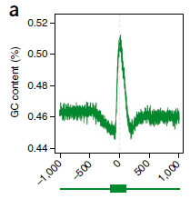
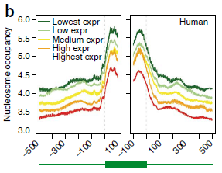
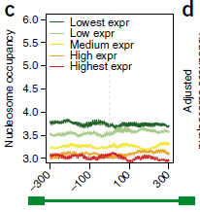
Nucleosomes preferentially bind to exons rather than introns:
(a) GC content within the 2000 nt window surrounding the center of constitutive exons.
(b) Nucleosome occupancy based on direct sequencing of nucleosome ends in activated T cells. Exons were aligned by their 3′ splice site (left) or by their 5′ splice site (right). Exons were divided into 5 bins on the basis of transcript expression levels in activated T cells. Inverse correlation between gene expression levels and nucleosome occupancy within exons – nucleosomes are depleted in actively transcribed regions
(c) Nucleosome occupancy as in (b), presented for a window of 600 nt surrounding the center of introns.

Slide 6
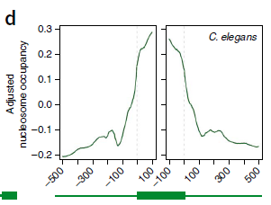
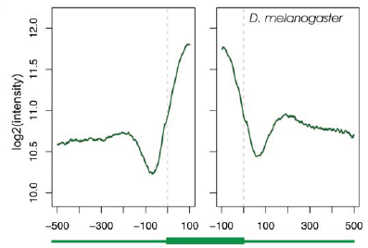
Further verification:
(d) Nucleosome-occupancy levels in C. elegans, aligned by 3′ splice site (left) or by 5′ splice site (right). (nucleosome position map based on SOLiD parallel sequencing, mapped against dataset of 89343 exons from C. elegans)
(e) Nucleosome occupancies along exonic and intronic regions in D. melanogaster, based on analysis of Mnase treated chromatin hybridized to tiling arrays. Intensities are log2 transformed.

Slide 7
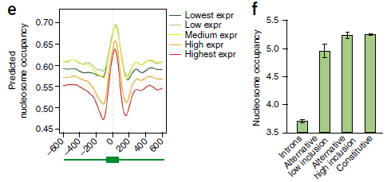
(e) Predicted nucleosome occupancy (sequence based model from Segal lab) in a 2000-nt window surrounding the center of exons. Exons were distributed into 5 equally sized bins on the basis of expression levels as in (b).
(f) Mean nucleosome occupancy in introns, alternatively spliced exons included in less than 50% of transcripts, alternatively spliced exons included in at least 50% of transcripts and constitutively spliced exons - correlate with inclusion levels.

Slide 8
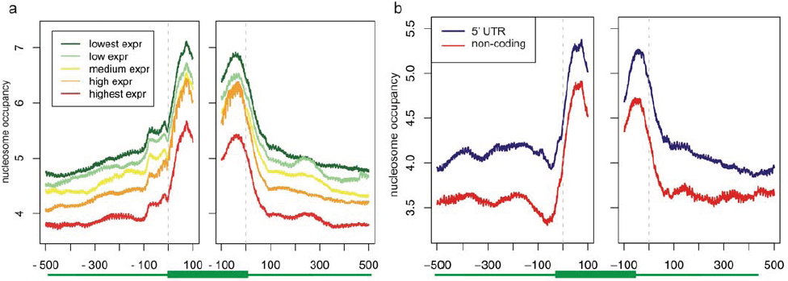
(a) Nucleosome occupancy based on direct sequencing of nucleosome ends in resting T cells. Exons were aligned by their 3′ splice site (left) or by their 5′ splice site (right). Exons were divided into 5 bins on the basis of transcript expression levels in resting T cells.
(b) Nucleosome occupancy levels in activated T cells along non-coding exons in the 1000 nt surrounding the exons. Two sets sets of non-coding exons are shown: internal exons fully residing in the 5′ UTR and internal exons from non-coding genes.

Slide 9
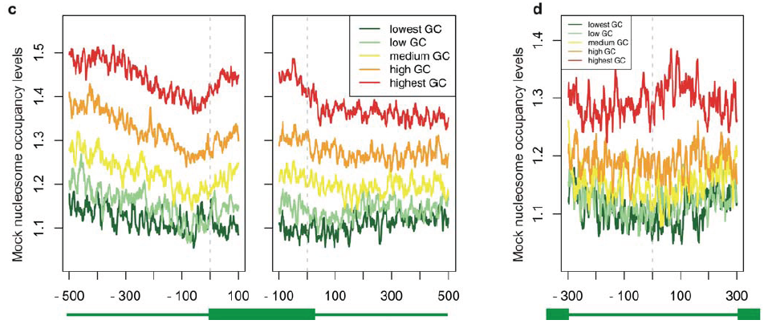
(c) Mock levels of nucleosome occupancy in the region surrounding the 3′ ss and 5′ ss of constitutive exons, after dividing them into 5 bins based on gradually increasing GC content. Mock nucleosome occupancy levels were calculated based on a dataset of sheared DNA in Jurkat cells.
(d) Analysis as c, but for the 600 nt surrounding the center of introns.

Slide 10
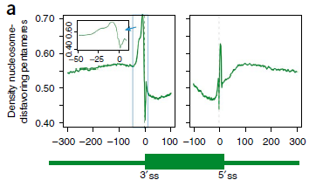
The splicing code and the chromatin code overlap:
Dataset:
From yeast nucleosome data (Field et al, 2008), all 1024 possible pentamers were scored on the basis of their emperically observed tendency to be covered by a nucleosome. From this pentamer scoring table, 248 pentamers that disfavored nucleosome binding were extracted.
Distribution of nucleosome- disfavoring sequences identified within the 600-nt region surrounding human constitutively spliced exons aligned at the 3′ splice site (3′ ss left) or at the 5′ splice site (5′ ss, right). The ordinate depicts the fraction of exons in which a given position is overlapped by a nucleosome-disfavoring sequence. – The peak at 5′ splice site is narrow and represents the specific nucleotide composition of that site.

Slide 11
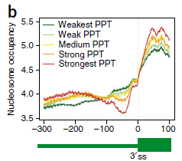
Polypyrimidine Tract:
The polypyrimidine tract is a region of messenger RNA (mRNA) that promotes the assembly of the spliceosome, the protein complex specialized for carrying out RNA splicing during the process of post-transcriptional modification. The region is rich with pyrimidine nucleotides, especially uracil, and is usually 15-20 base pairs long, located about 5-40 base pairs before the 3' end of the intron to be spliced.
Nucleosome- occupancy levels in activated T cells within 300-nt upstream and 100-nt downstream of the 3′ ss. Introns were divided into 5 bins on the basis of the strength of their PPT. – Stronger PPTs are linked with decreased nucleosome occupancy within the intronic regions immediately preceding exons, but with increased nucleosome occupancy within exons.
At the RNA level PPT functions in mRNA splicing, at the DNA level, it serves to discriminate between exons and introns in terms of nucleosome occupancy.

Slide 12
Extent of overlap of splicing regulatory elements with nucleosome favoring and disfavoring pentamers:
Nucleosome (disfavoring / favoring) > 1.0 → enriched in linker
Nucleosome (disfavoring / favoring) > 1.5 → highly enriched in linker
Nucleosome (favoring / disfavoring) > 1.0 → slightly enriched in nucleosome
Nucleosome (favoring / disfavoring) > 1.5 → enriched in nucleosome
Nucleosome (favoring / disfavoring) > 2.0 → highly enriched in nucleosome
Datasets:
Intronic splicing regulatory elements (ISRs): Yeo et al, 2007 & Voelker et al, 2007.
Exonic splicing regulatory elements (ESRs): Fairbrother et al, 2002, Goren et al, 2006 & Wang et al, 2004.
The set of 1024 pentamers was divided into 5 bins on the basis of nucleosome disfavoring/favoring ratios. Then the extent and significance of overlap between the sequences in each of these bins were determined with datasets of ISRs and ESRs.

Slide 13
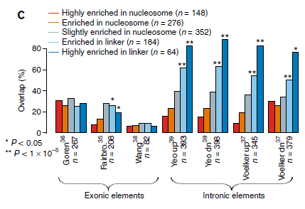
Overlap between nucleosome favoring or disfavoring sequences and between different groups of splicing regulatory elements. The 1024 possible pentamers were divided into 5 bins on the basis of their nucleosome-favoring or disfavoring score.
For each group of splicing regulatory sequences (labeled by the first author accordingly), the fraction of overlapping sequences in each nucleosome favoring or disfavoring bin was calculated. Levels of significance are indicated by 1 or 2 asteriks, indicating hypergeometric p-values of p < 0.05 or p < 1×10-5, respectively.
Significant values of this test for a given nucleosome favoring or disfavoring bin indicate that the overlap between nucleosome favoring or disfavoring pentamers in that bin and a given set of SREs is significantly greater than by chance.
‘up’ and ‘dn’ refer to the data sets of k-mers found to be enriched upstream or downstream of exons respectively.

Slide 14
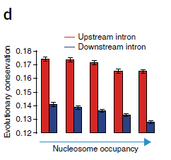
So ISRs, both upstream and downstream of exons, tended to be significantly and highly enriched in nucleosome disfavoring sequences – this was not the case for ESRs.
This indicates that one role of ISRs, which were originally identified on the basis of their overabundance and high conservation within intronic regions adjacent to exons, may be to control the exon-intron nucleosome occupancy gradient.
Supporting this hypothesis, inverse correlation between nucleosome occupancy and conservation was observed in the 50 nt within introns that immediately precede and follow an exon, possibly indicative of evolutionary pressure to maintain nucleosome-free regions at both ends of exons.
Mean consevation levels, based on phastCons scores for 18 placental organisms, within the 50 intronic nucleotides preceding and following exons. Exons were divided into 5 groups on the basis of the mean nucleosome occupancy levels in activated T cells within the respective intronic regions.

Slide 15
Post-translational modifications enriched along exons:
The fact that exons tended to be occupied by nucleosomes raised the possibility that specific modifications of histones may mark exons as well.
Dataset:
Genome-wide ChIP-seq data sets were analyzed containing data on sequences bound by histones with 38 modifications in human activated T cells. Site identification from short sequence reads (SISSRs) were used to identify genomic regions enriched with each modification.
The prevalence of every enriched region across a 2000 nt window surrounding the center of exons were assessed, after dividing the exons into five equally sized bins on the basis of the expression levels of transcripts in activated T cells.
Correlation between nucleosome occupancy levels along exons and H3K36me3 modification levels.

Slide 16
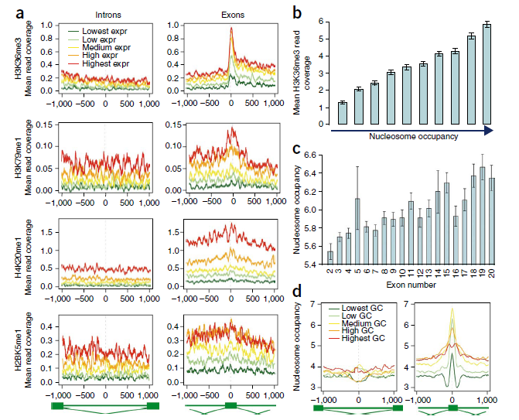
All exons divided into 10 bins of gradually increasing occupancy
Increased levels of nucleosome coverage in 3’ exons

Slide 17
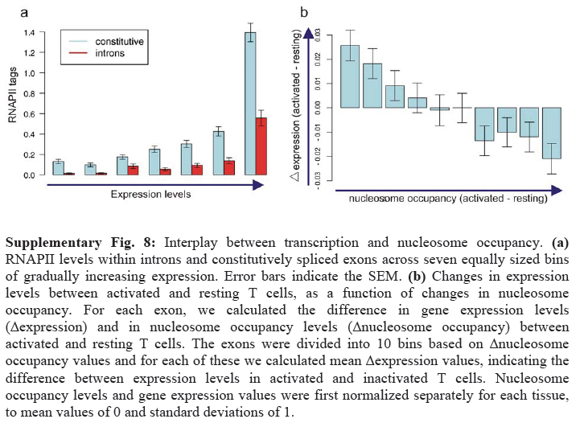
Levels of binding of RNAPII is higher in exons than introns:

Slide 18
Binding levels of RNAPII are increased in exons, compared to introns, across all levels of expression – this may suggest that nucleosomes bound within exons and introns could serve as ‘speed bumps’ that slow the rate of RNAPII, thereby improving selection of exons.
The interplay between expression and nucleosome occupancy were examined – from the dynamics of exonic nucleosome occupancy levels in activated and inactivated T cells as a function of changes in gene expression levels between these two conditions, it is found that decreased nucleosome occupancy in a given condition correlated with increased expression and vice versa.
This demonstrates that nucleosome occupancy levels are dynamically altered and that changes in these levels are linked with changes in expression levels.

Slide 19
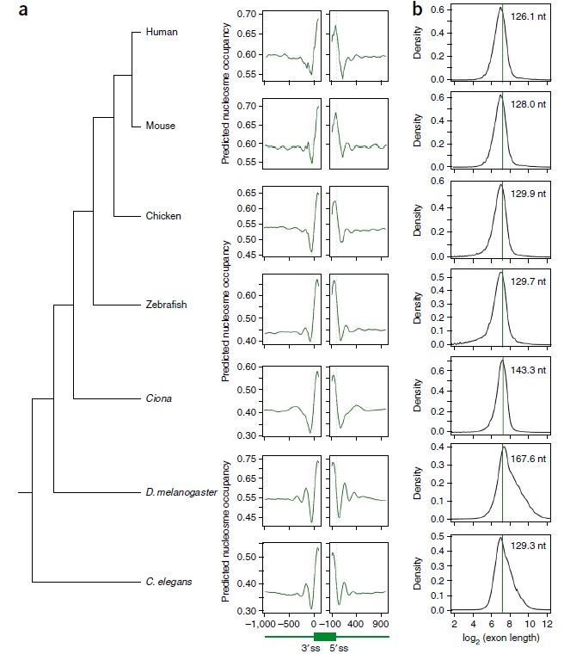
Exons harbor nucleosomes throughout metazoan evolution:

Slide 20
Conclusion:
Marking of exons by nucleosomes may have a role in defining the exon-intron architecture of a gene.
Thus, the tendency to be occupied by mono-nucleosomes may be one of the forces that acts on exons to keep their length within their observed range.
Nucleosome positioning at the DNA level may affect exon recognition at the RNA level through at least two mechanisms:
Nucleosome function as ‘speed bumps’ to slow the rate of RNAPII elongation. A reduction in transcription rate has been shown to increase inclusion of alternatively spliced exons.
Preferential positioning of nucleosomes along exons marks the exons with specifically modified histones that subsequently interact with the splicing machinery to enhance recognition of exons.
H3K36me3 –modified nucleosomes, which preferentially bind within exons, may serve as a scaffold for recruiting different splicing factors.
A nonmutually exclusive possibility is that nucleosomes confer protection to the exonic sequences coiled around them.

