Slide 1
A hidden reservoir of integrative elements is the major source of recently acquired foreign genes and ORFans in archaeal and bacterial genomes
Genome Biology 2009, 10:R65
Diego Cortez, Patrick Forterre and Simonetta Gribaldo
Institut Pasteur, Département de Microbiologie,
Unité de Biologie Moléculaire du Gène chez les Extrêmophiles, Rue du Dr Roux, 75724 PARIS cedex 15, France.

Slide 2
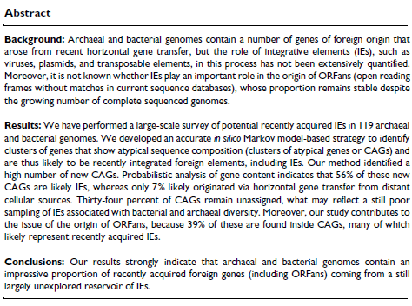

Slide 3
Integrative elements (IEs)
Integrative elements (IEs) such as viruses and plasmids and their associated hitchhiking elements, transposons, integrons, and so on, mediate the movement of DNA within genomes and between genomes.
They are playing a key role in the emergence of infectious diseases, antibiotic resistance, and biotransformation of xenobiotics.
The importance of IEs in the origin of ORFans (open reading frames (ORFs) without matches in current sequence databases) is still controversial. Indeed, the source of ORFans remains a major mystery of the post-genomic era since, contrary to previous expectations, their proportion remains stable despite the increasing number of complete genome sequences available.

Slide 4
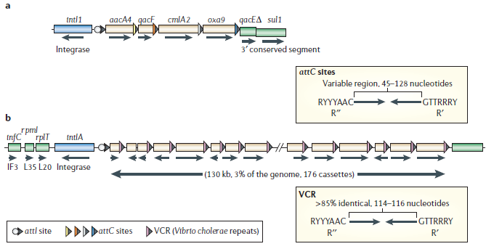
Integron
Integrons are assembly platforms that incorporate exogenous ORFs by site-specific recombination and convert them to functional genes by ensuring their correct expression.
Three key elements necessary for the capture of exogenous genes: a gene (intI) encoding an integrase belonging to the tyrosine-recombinase family; a primary recombination site (attI); and an outward- orientated promoter (Pc) that directs transcription of the captured genes.
An imperfect inverted repeat at the 3′ end conserved segment of the gene called an (attC) site (or 59-base element). The attC sites are a diverse family of nucleotide sequences that function as recognition sites for the site-specific integrase.

Slide 5
Origin of ORFans
Misannotated genes, rapidly evolving sequences, newly formed genes, or genes recently transferred from not yet sequenced cellular or viral genomes.
The possibility that ORFans originate from the integration of elements of viral origin is appealing since viral genomes themselves always contain a high proportion of ORFans.
Daubin and Ochman: ORFans from γ-Proteobacteria share several features with viral ORFans (for example, small size, AT-rich) and suggested that 'ORFans in the genomes of free-living microorganisms apparently derive from bacteriophages and occasionally become established by assuming roles in key cellular functions.

Slide 6
Composition base methods
Atypical G+C content, atypical codon usage, Markov model (MM)- based approaches, and Bayesian model (BM)-based approaches.
MM approaches are based on one order Markov chains to identify those ORFs that have a composition different from genes that are likely native.
BM approaches identify those ORFs with under-represented compositions with respect to the composition of the whole genome.
To quantify more precisely the role of IEs in the introduction of foreign genes in bacterial and archaeal genomes and in the origin of ORFans.
To develop an accurate and statistically validated MM-based strategy to search 119 archaeal and bacterial genomes for 'clusters of atypical genes' (CAGs), since these likely represent recently integrated foreign elements, including IEs.

Slide 7
Materials and methods: Analyzed genomes
All genomes were obtained from the NCBI database.
19 groups of closely related genomes: (same genus or order) 119 genomes in total.
Group I, Archaea: Thermococcales, four genomes; Methanosarcinales, three genomes; Halobacteriales, four genomes; Thermoplasmatales, three genomes; Sulfolobales, three genomes; Methanococcus, seven genomes; Pyrobaculum, four genomes.
Group II, Bacteria: γ-Proteobacteria (Escherichia, Salmonella and Yersinia), 13 genomes; ε-Proteobacteria (Helicobacter), four genomes; α-Proteobacteria (Rickettsia), five genomes; Firmicutes (Bacillus, 11 genomes; Staphylococcus, 12 genomes; Streptococcus, 6 genomes; Lactobacillus, 10 genomes); Actinobacteria, Mycobacterium), ten genomes; Chlamydia, 7 genomes; Spirochaetes (Leptospira), three genomes; Cyanobacteria (Synechococcus, five genomes; Prochlorococcus, five genomes).

Slide 8
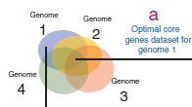
Core genes datasets
To define 'core genes' datasets, best bi-directional BLASTP searches were performed with the ORFs of each genome against those of the other members of the group. All hits having a bit score higher than 30% of the bit score of the seed against itself were considered as orthologues.
For each analyzed genome, 11 datasets of core genes were created:
all the genes in the genome, orthologues present in 10% of the group‘s genomes, orthologues present in 20% of the group's genomes, and so on, up to orthologues present in 100% of the group's genomes.
For each genome, 11 MMs were built base on these different core genes datasets.

Slide 9
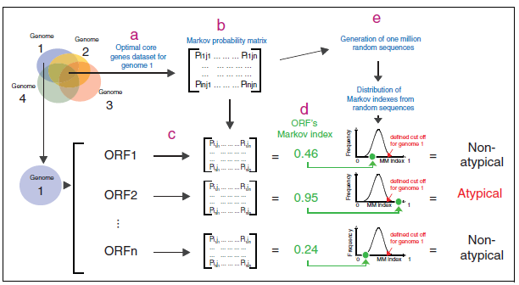
Result 1: Markov model-based strategy for identification of atypical ORFs
58,487 ORFs out of 351,111 in total (16%) were indentified as atypical composition in 119 genomes.

Slide 10
Efficiency of MM, BM and GC% approach
To test the efficiency of MM approach, the BM approach, and a GC% approach for detecting atypical ORFs .
In silico HGT was performed two simulations in all 119 archaeal and bacterial genomes using all 11 different core genes datasets.
In the first simulation, 100 ORFs were chosen from the other 118 genomes and these were introduced in silico in the genome under analysis and determined the number of simulated HGTs that were detected as atypical (true positives, expected to be high).
In the second simulation, 100 random ORFs were chosen from a strict core genes dataset (that is, genes conserved in all genomes of the group, thus assumed to be native) and determined the average number of these that were detected as atypical (false positives, expected to be low).

Slide 11
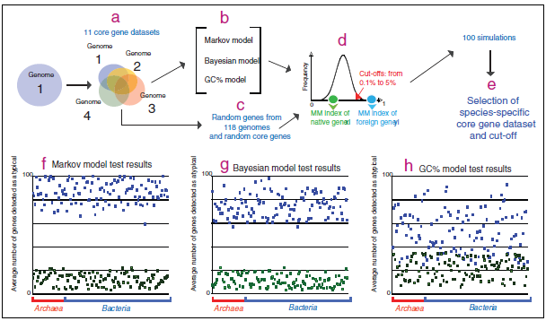
Result 2: HGT simulations using MM, BM and %GC content based methods
Blue dots represented true positives and Green dots represented false positives.

Slide 12
Identification CAGs and Origin of CAGs
Searched for atypical genes that cluster together called Cluster of atypical genes (CAGs), using a sliding window of ten ORFs that moved along the genome sequence, and every time seven or more ORFs in that window showed an atypical composition so it defined a cluster.
To observe origin of CAGs, All ORFs contained in annotated IEs (10,651 ORFs) and newly identified CAGs (36,790) were searched by BLASTP against:
A local database of all annotated IEs in the 119 genomes
Complete plasmid sequences available at the NCBI
Complete viral genomes at the NCBI
A local database of core genes in the 119 genomes (from the selected core genes dataset after the HGT simulations; 194,554 genes)
BLASTP searches were performed against four metagenomic databases available at the SDSU Center for Universal Microbial Sequencing: 'The marine viromes of four oceanic regions'.

Slide 13
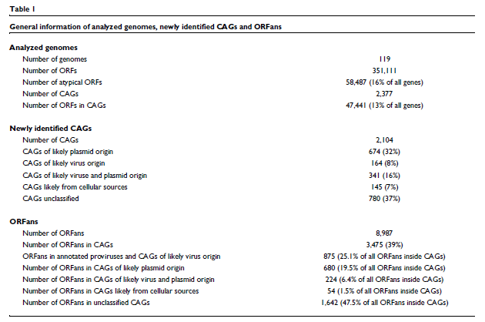

Slide 14
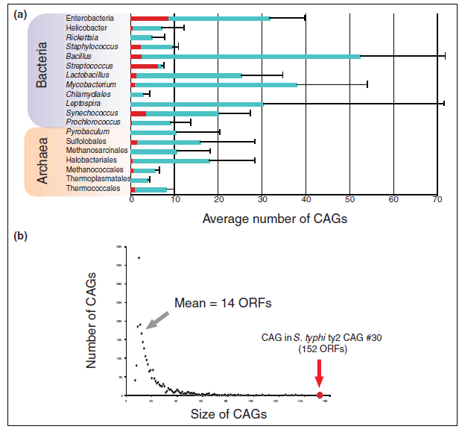
(a) Average number and standard deviations of CAGs in the different analyzed groups of Archaea and Bacteria.
In red are represented the average numbers of annotated IEs.
(b) CAGs size distribution.

Slide 15
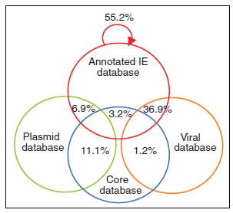
Proportion of homologues from annotated IEs
A local database containing all ORFs from annotated IEs (annotated IE database)
A local database containing all our species-specific core genes from all genomes analyzed (core database)
The complete viral genome database available at NCBI (as for January 2009; viral database)
The complete plasmid genome database at NCBI (as for January 2009; plasmid database)

Slide 16
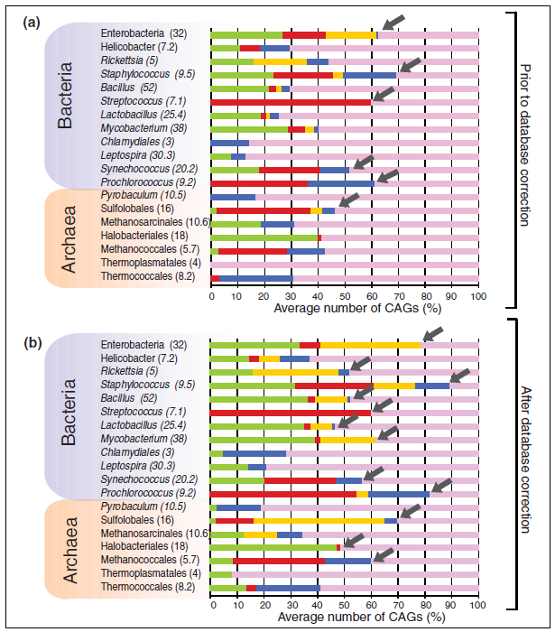
Newly identified CAGs of likely IE origin
(a) Proportion of newly identified CAGs of plasmid origin (green -21% to be 32%(b))
viral origin (red – 8% same (b))
viral/plasmid origin (yellow -4% to be 16% (b))
cellular origin (blue-4% to be 7% (b) )
unassigned (violet-67% to be 37% (b))
(b) Same as in (a) but after database correction.
Each group's average number of CAGs is indicated in parentheses.
Grey arrows indicate the groups with the highest proportions of newly identified CAGs classified as IEs.

Slide 17
Detection of ORFans
All ORFs in the 119 analyzed genomes were searched by BLASTP against the nr database at the NCBI (as of January 2009). When no hits were found below an e-value of 0.001, ORFs were considered as ORFans.
To correct the list of ORFans by eliminating potential misannotated ORFs.
In fact, 1,859 potential ORFans were found in more than one genome by using a BLASTN search (cut-off was fixed at 50% of bit score of the query sequence against itself).
Total number of ORFans (8,987) (table 1)

Slide 18
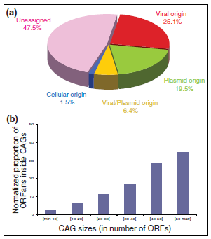
ORFan distribution.
(a) Distribution of ORFans in CAGs: ORFans in CAGs of
Viral origin (red)
Plasmid origin (green)
Viral/plasmid origin (yellow)
Cellular origin (blue);
Unassigned CAGs (violet)
(b) Proportion of ORFans inside CAGs of different sizes.
Data were normalized according to the number of CAGs in each category.

Slide 19
Conclusion
MM-based method to identify ORFs with atypical composition in groups of closely related genomes, coupled to the identification of CAGs, their genomic context and gene content, is a powerful approach to identify foreign elements that have recently integrated into archaeal and bacterial genomes.
This strategy allowed us to recognize all previously annotated IEs and to detect new CAGs that are likely of viral or plasmid origin in a large number of archaeal and bacterial genomes.
The hidden IE reservoir hypothesis also explains why the proportion of ORFans remains stable despite the growing number of new genome sequences.
This proportion will start decreasing only with a more exhaustive sequencing of all IEs associated with a particular bacterial or archaeal species.
The study of the expression profiles, functions and structures of these ORFans should become one of the priorities of postgenomics studies.

Slide 20
Models
Eleven first-order Markov-based models were constructed for each genome for each different core genes dataset. The models take into account the Markov probability matrix of the different core genes datasets and the composition of the ORF under study. The model is based on the mathematic formulas
where S(m) is the Markov index for the m sequence,
h is sequence length of the gene m,
P(xy) set ORFi are the dinucleotide probabilities found in the ORF i under study,
P(xy)set coregeneX% are the dinucleotide probabilities calculated from the core genes dataset calculated from gene sequences from the organisms under study having orthologues in at least X% of the group's genomes.

Slide 21
Detail of MM and cut-off
In order to assess significance cutoffs for Markov indexes, we applied Monte Carlo simulations; for every ORF of a particular group analyzed, one million random sequences were generated based on the Markov model probability matrix of the core genes dataset, and the Markov index of each of these random sequences was calculated. Then, the results were analyzed by a one-tailed test with different distribution cut-offs (0.l% to 5%).
An ORF having a Markov index above a specific cut-off was then considered as atypical. The Bayesian model was built but with our different core genes datasets and our Monte Carlo simulations to define statistical thresholds.
The GC% model looks for the differences between a give ORF and a dataset of core sequences by looking at the GC% variability in the third codon base. The model was applied using the different core genes datasets and our Monte Carlo simulations to define statistical thresholds. Genes that are atypical per se (approximately 10% of all core genes analyzed), such as genes coding for ribosomal proteins or genes smaller than 150 nucleotides, were excluded from further analysis.

Slide 22
Horizontal gene transfer simulations
The MM, BM and GC% approaches were evaluated using in silico HGT simulations in order to test their performances under different genomic backgrounds.
The 119 genomes were analyzed and 100 simulations were performed using the core genes datasets and a variety of cut-offs (0.1% to 5%).
Higher Markov orders were also tested, but these showed lower specificity (that is, higher numbers of false positives; data not shown), probably because with our Markov chain approach the increase in the Markov order reduces considerably the quantity of information that can be obtained from the gene sequence, especially for small genes. To evaluate the average performances of the models, we applied a Wilcoxon-test.

Slide 23
Gene content probabilistic analysis
One-thousand clusters of size n, where n goes from 7 ORFs (smaller CAG by definition) up to 152 ORFs (larger CAG found) were artificially built using ORFs from the 119 analyzed genomes. Counting for all clusters of n size, the number of homologues they have in the viral genome database, the plasmid genome database and the core genes database.
Each ORFs were allowed to have only one homologue in each database in order to reduce any possible biases due to the presence of closely related sequences in the database that would falsely increase the number of homologues for a given ORF. Based on these data, three distributions of were built probabilities (one for each of the above-mentioned databases), and from these distributions were used to calculate a 95% confidence interval.
To determine which CAGs are of viral or plasmid or cellular origin by counting the number of homologues their ORFs show in the viral genome database and the plasmid database and the core genes database.
For instance, a CAG of size 'x' that has 'y' homologues in the plasmid database could be considered of plasmid origin when 'y' was above the 95% confidence interval calculated from the distribution of homologues in the plasmid database of the 1,000 random clusters of size 'x'.

Slide 24
ORFans and CAGs
For each genome, the expected number of ORFans inside CAGs were calculated by giving the total number of ORFs in the genome, the total number of ORFs in CAGs, and the total number of ORFans.
Because the data had a normal distribution, a χ2 test was performed to determine if the number of ORFans inside CAGs was higher than expected by chance only.
To analyze if CAGs are enriched in genes of small size and because data had a normal distribution, a one-way ANOVA test followed by a TukeyHSD statistical test were performed between all the groups of CAGs and 1,000 randomly chosen core genes.

